Slide 1


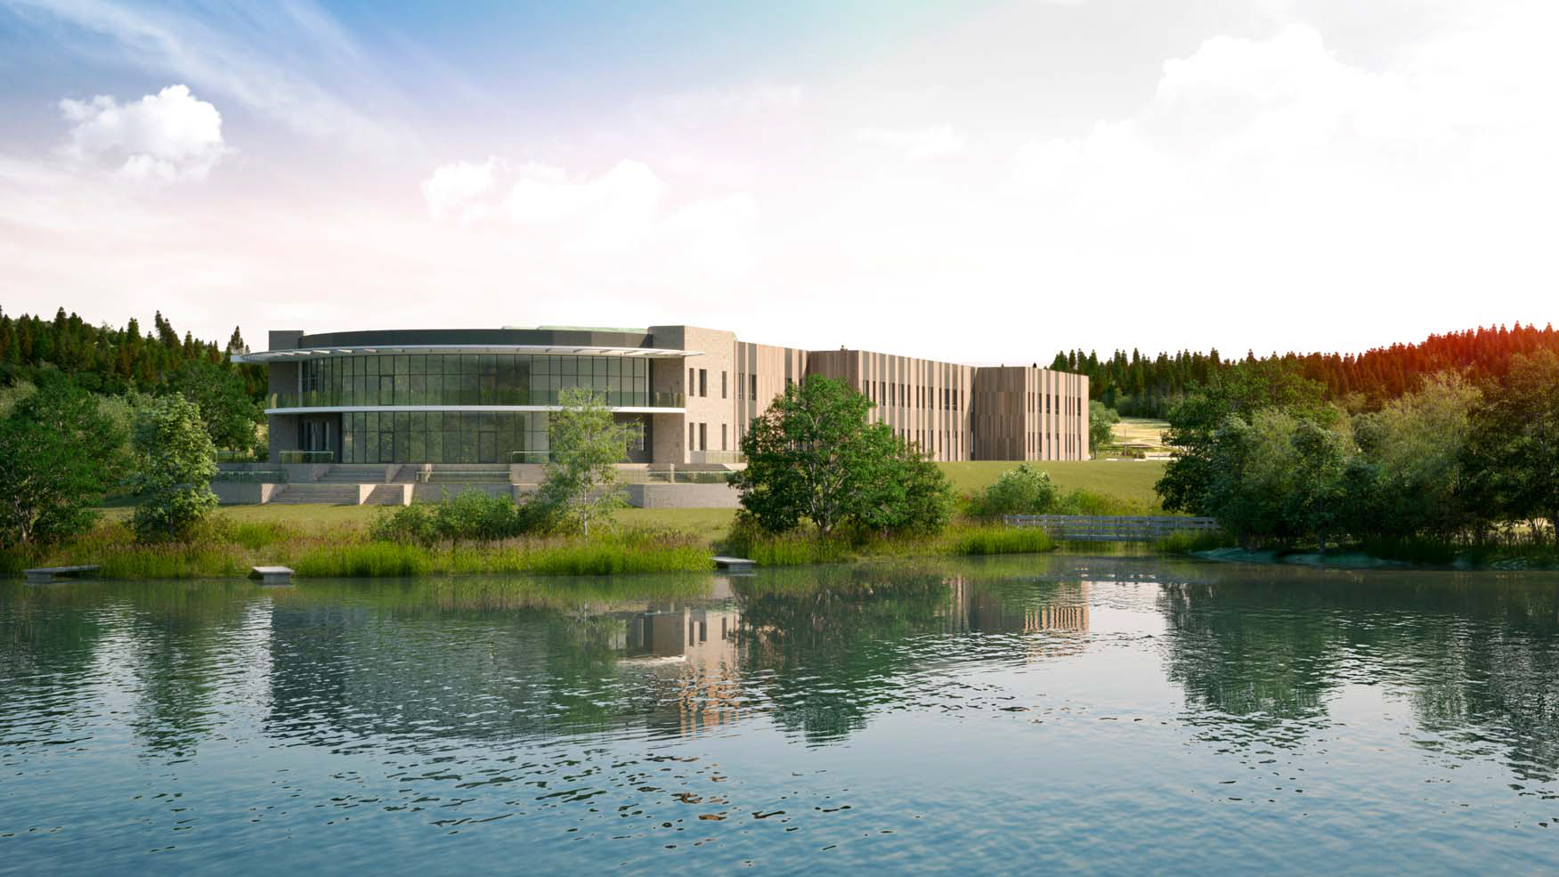
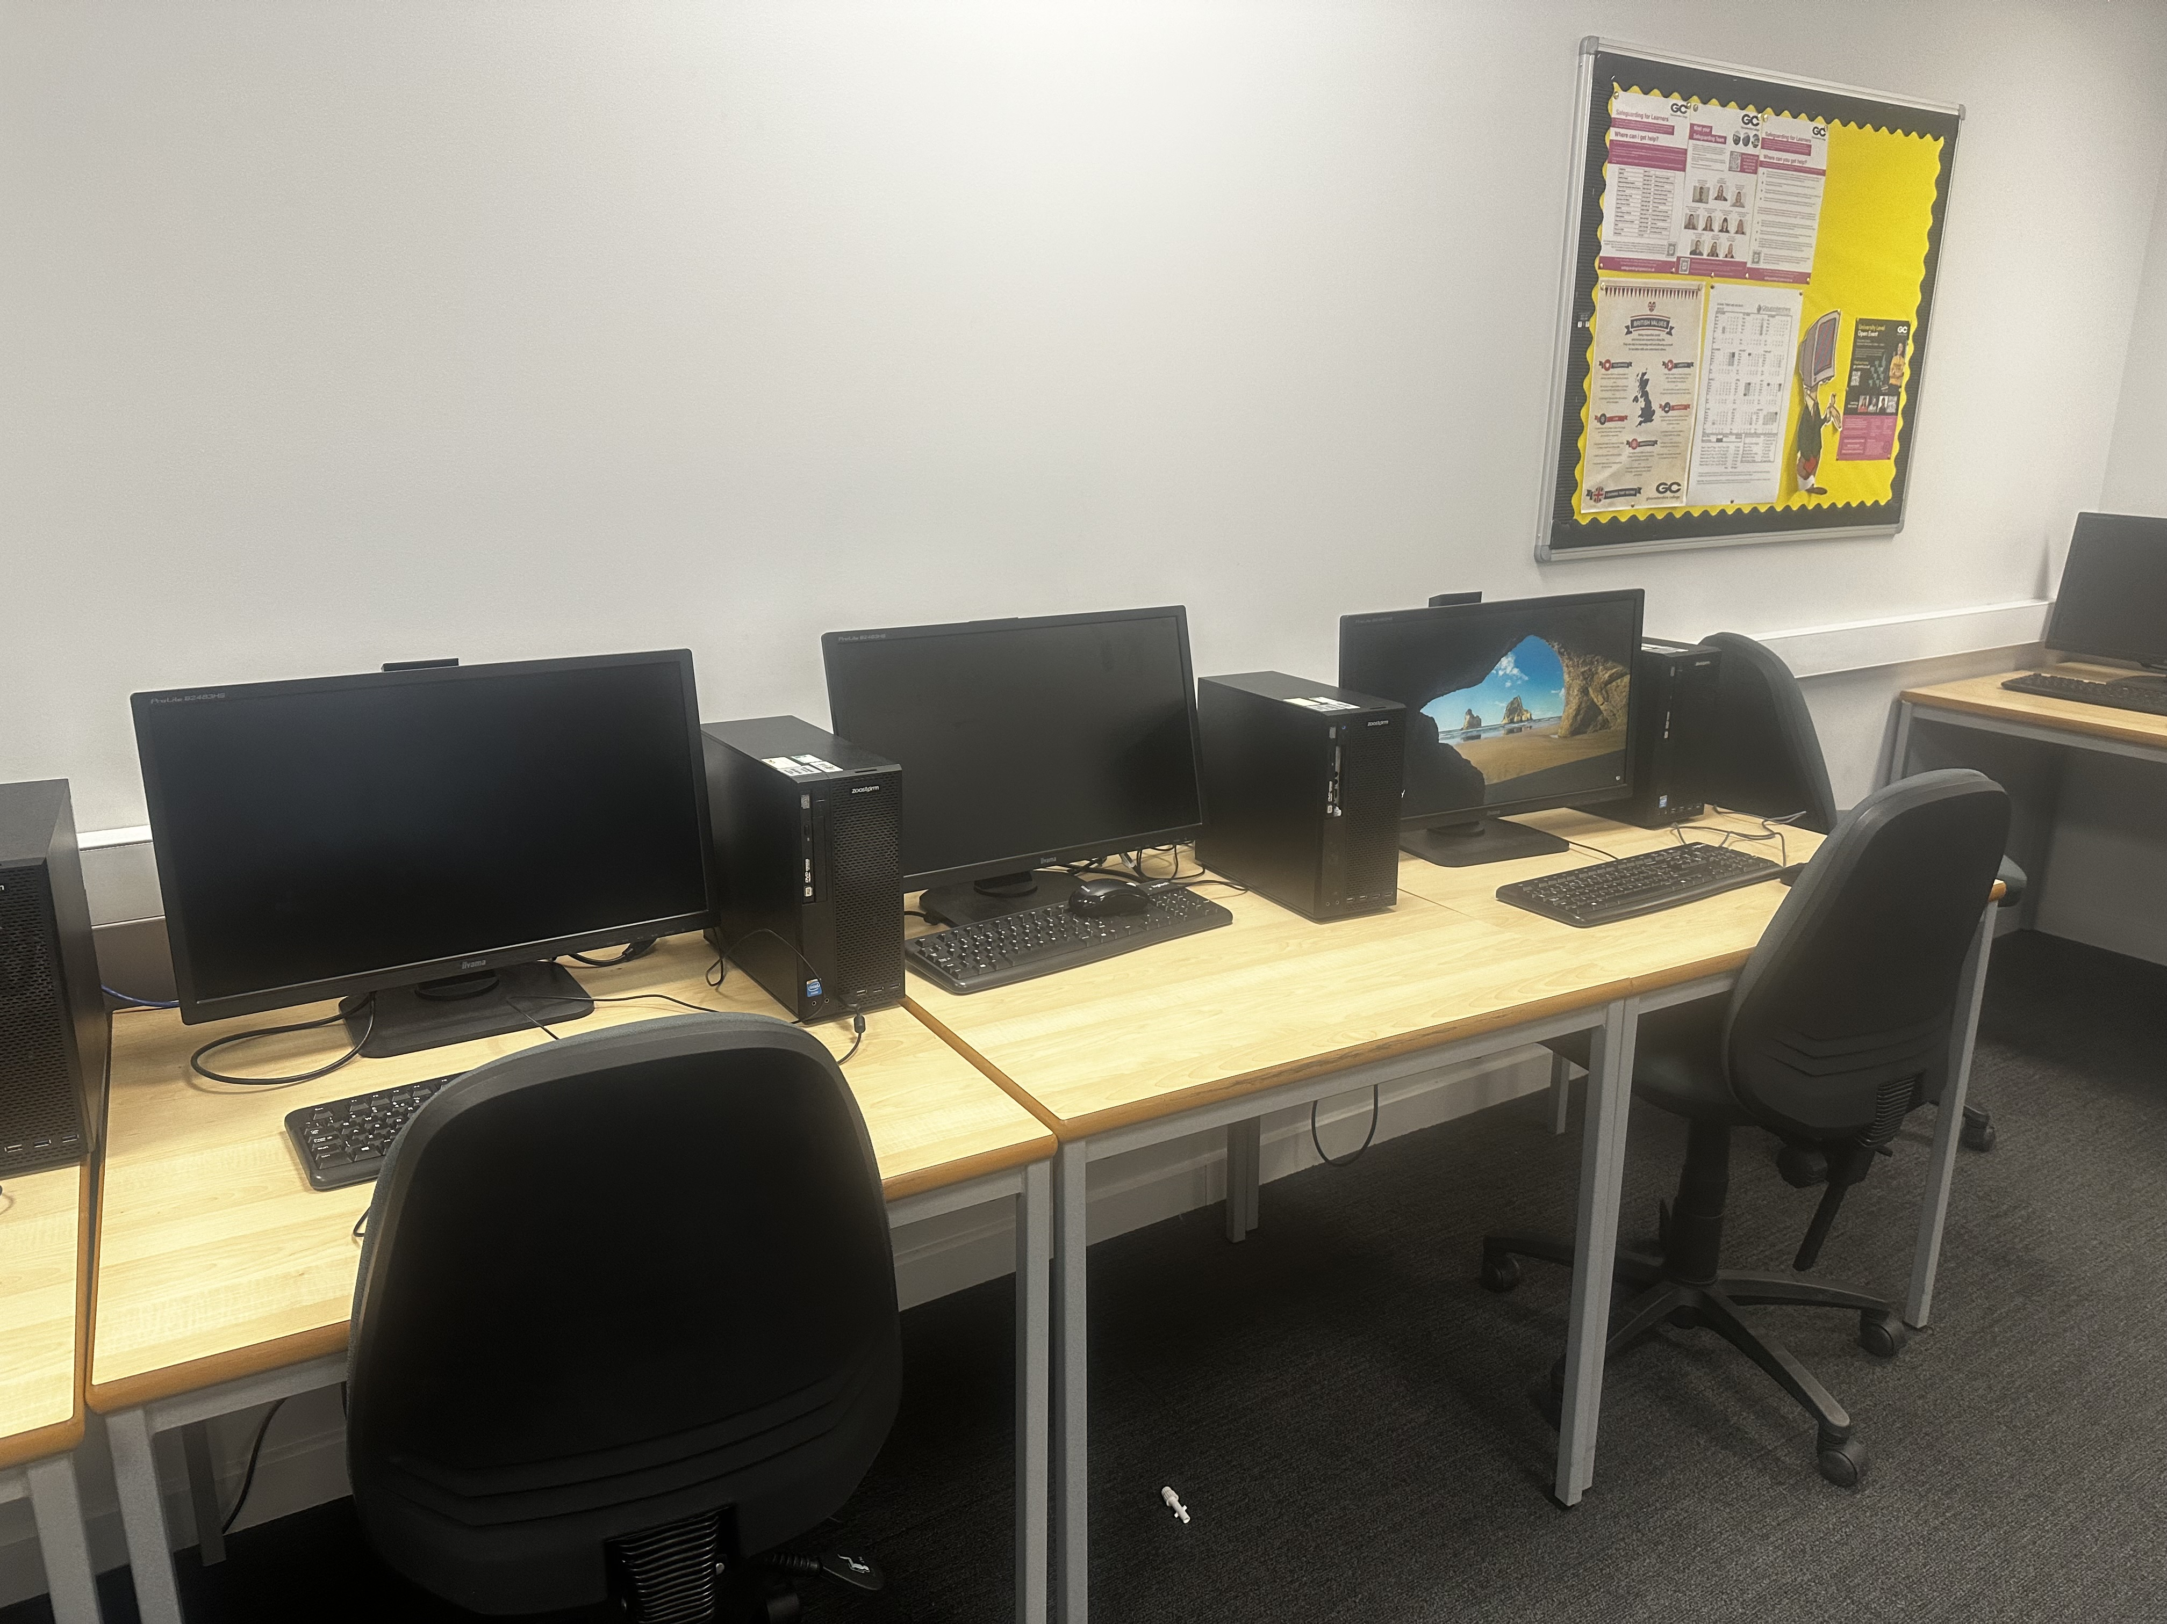
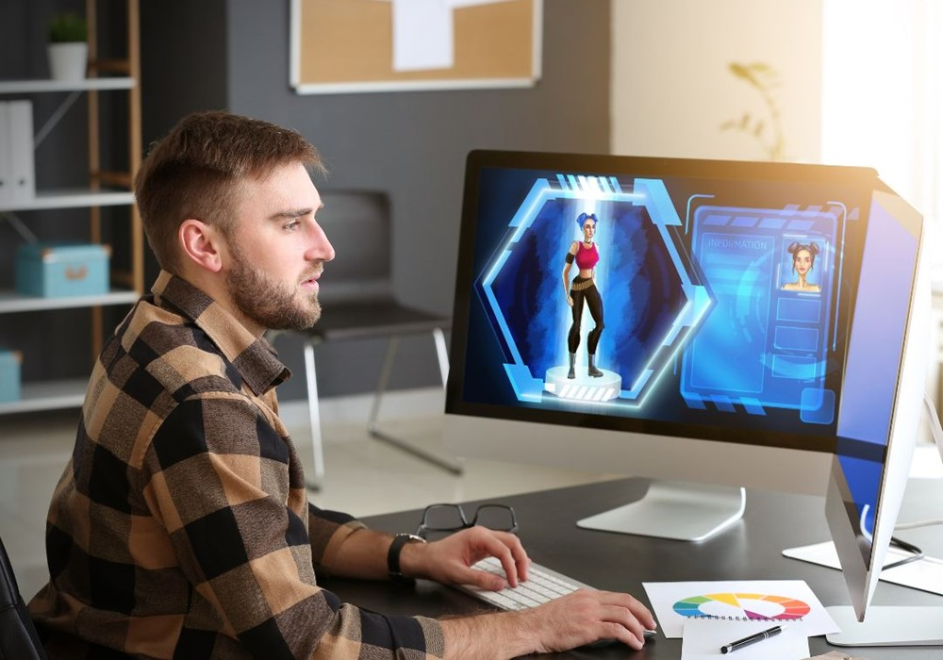
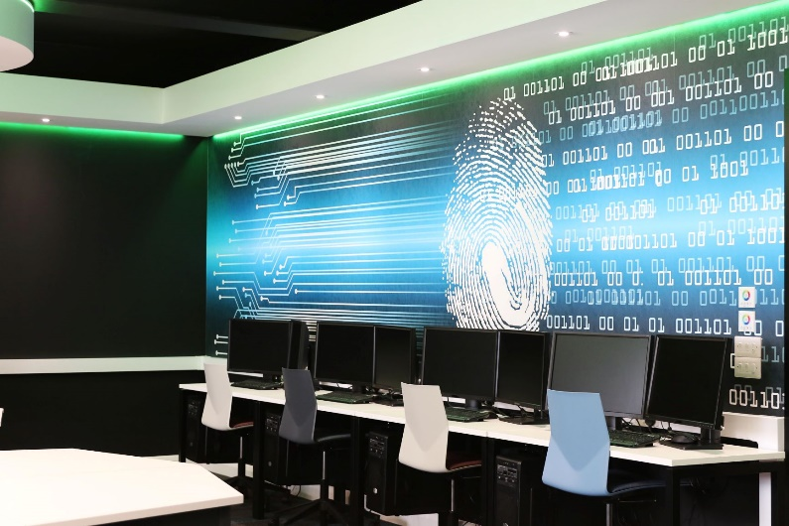

Welcome to:
Forest of Dean Campus’s
IT Department
Pick your desired course below!
Computing
Games Design
Cybersecurity
Unsure?

Slide 2

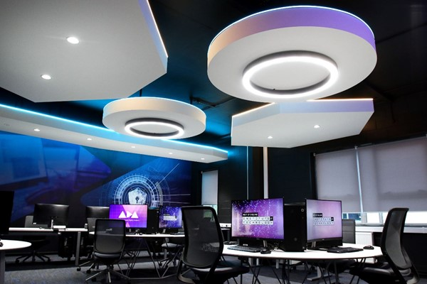
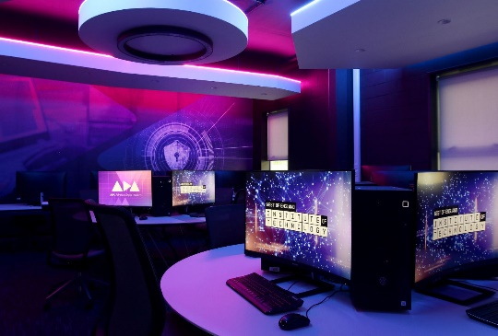
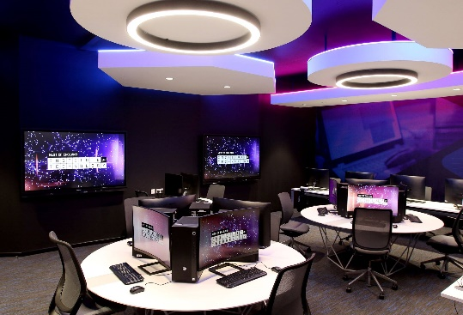
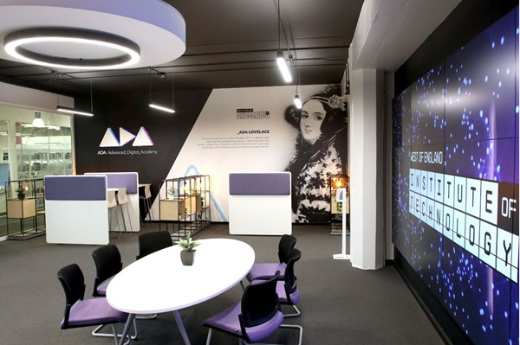
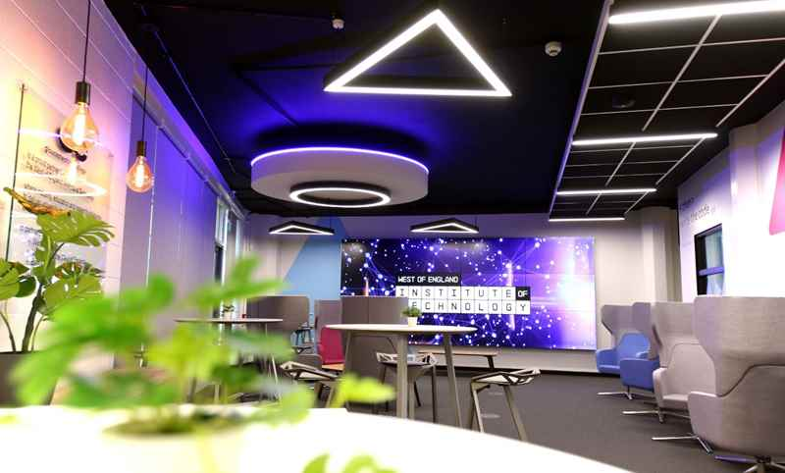
Computing
Welcome to Computing!
Computing is a Level 2 course that teaches you developmental computing skills. It covers all the basic skills needed to further a career in computing or to progress to a higher level of study. The course is in 4 sections. Each section covers different topics.
Section 1: Hardware and Software
Section 2: Web Design
Section 3: Interactive PowerPoint
Section 4: Mobile App Development
This course is ideal if you would like to learn about the computing industry and develop your essential computing skills.
The main things you will learn about is how to install hardware and software and maintaining them, technology systems, how to make a mobile phone app and how to install hardware and software and how to maintain them. Additionally, you’ll be taught how to make a digital portfolio for yourself, website development skills, multimedia and networking.
You’ll be expected to do a high degree of practical work and research at home for assignments. Students like yourself would love our local industry connections and regular guest speakers.
ADA Digital Academy at Cheltenham Campus

Slide 3
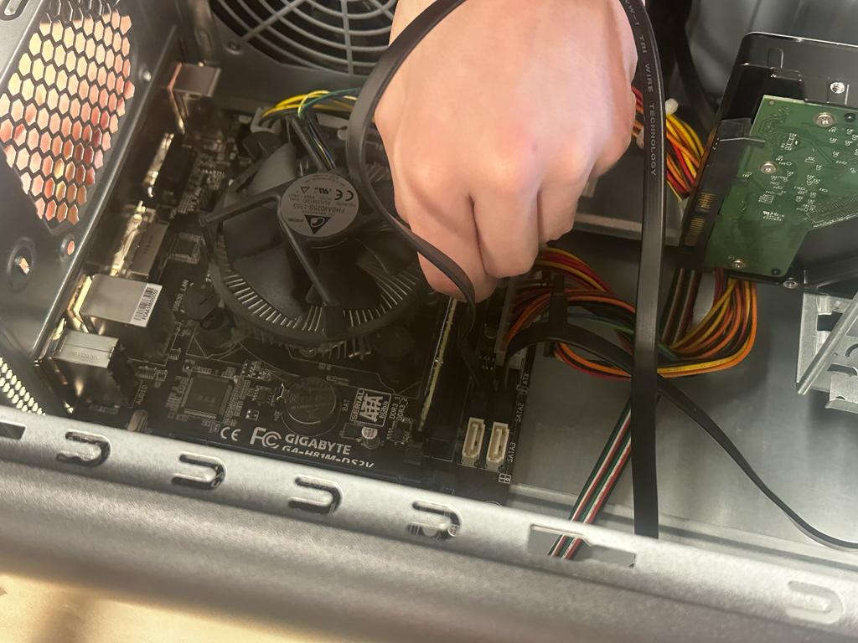
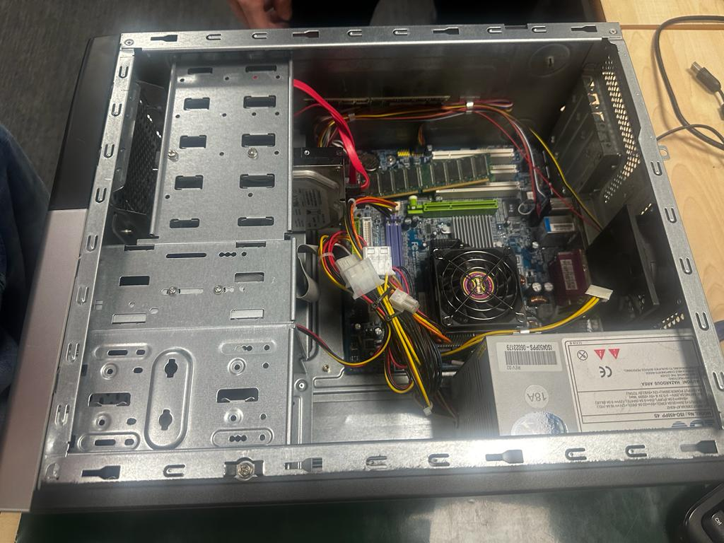
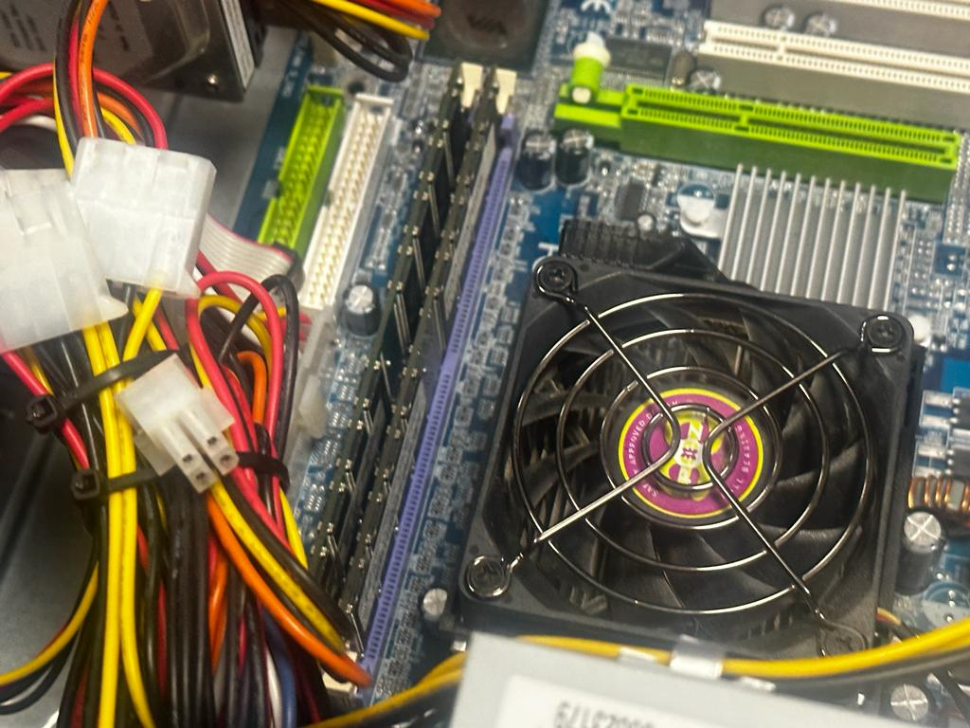
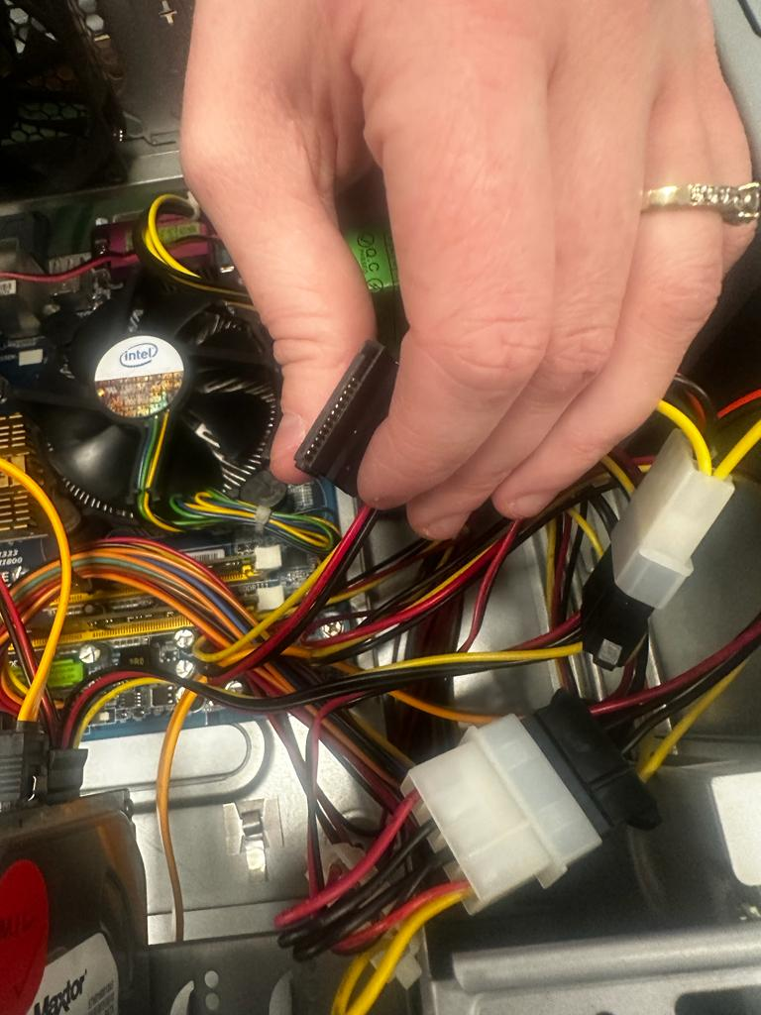
Computing
Welcome to Computing!
Hardware
During this course, we studied the components that make up a computer. We studies cables, RAM and ROM, and the maintenance of hardware. In this, we actually got to take a computer apart and find faults and fix them.

Slide 4


Computing
Welcome to Computing!
Software and its uses
During this part of the course, we studied different types of software and what their uses were like Utility software i.e. Windows Firewall, Photoshop, Microsoft Edge, and a few others – which help maintain or configure a computer, like antiviruses.
We also discussed and investigated compatibility in software and conflict issues. We worked on increased speed, increased compatibility and network requirements.
As part of the course, we installed and tested a virtual machine and set up the operating system software (which would be Ubuntu) in the virtual machine.

Slide 5
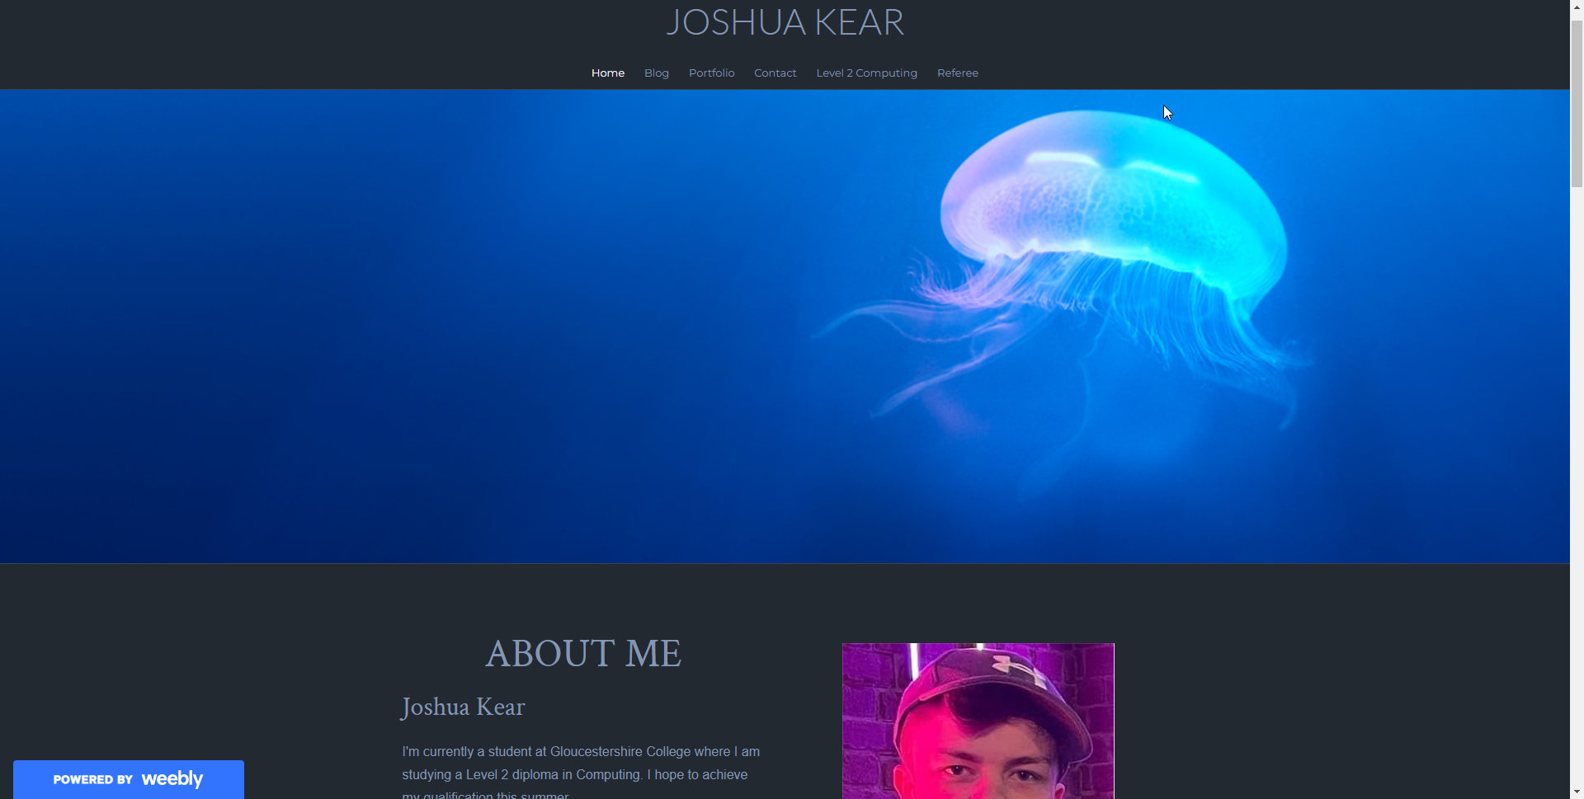
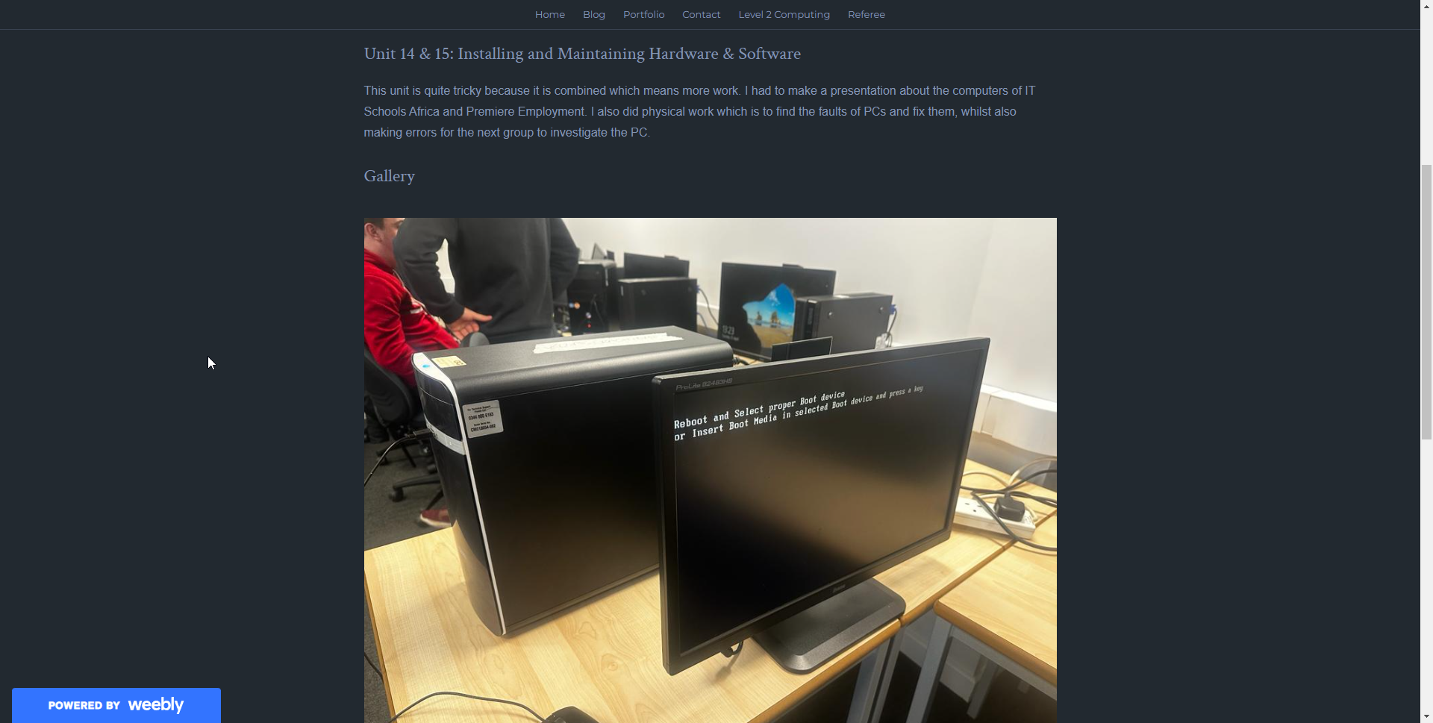
Computing
Welcome to Computing!
Web Design
As part of the course we looked at web design and designed our own interactive website for a festival. We had to investigate different website examples of festivals. We also produced our own portfolio and had a look at examples of different portfolios.

Slide 6
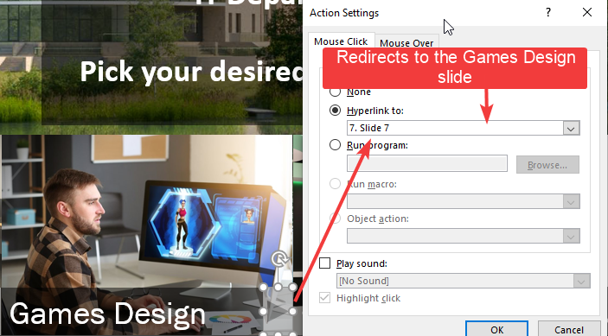
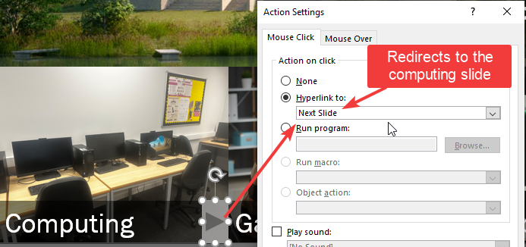
Computing
Welcome to Computing!
Interactive PowerPoint
We did a interactive powerpoint which we can use as a jobs CV or if we’re applying for further education. This powerpoint was easy to use, factual, lots of text and information with photos for backup. We put in hyperlinks to different slides, action buttons like the home button and other features for navigation. Great fun to do it and also very useful for the future.

Slide 7
Computing
Welcome to Computing!
Moving On…
After completing the course, you’ll be able to move on to a Level 3 course which allows you to study for Cybersecurity or Games Design
Cybersecurity
Games Design

Slide 8
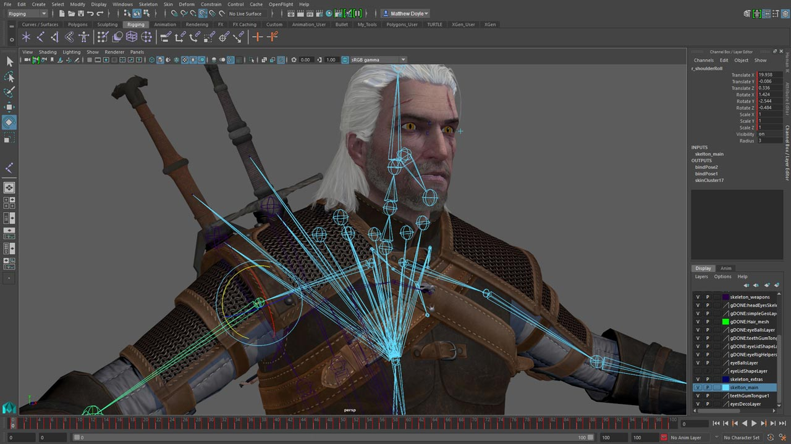
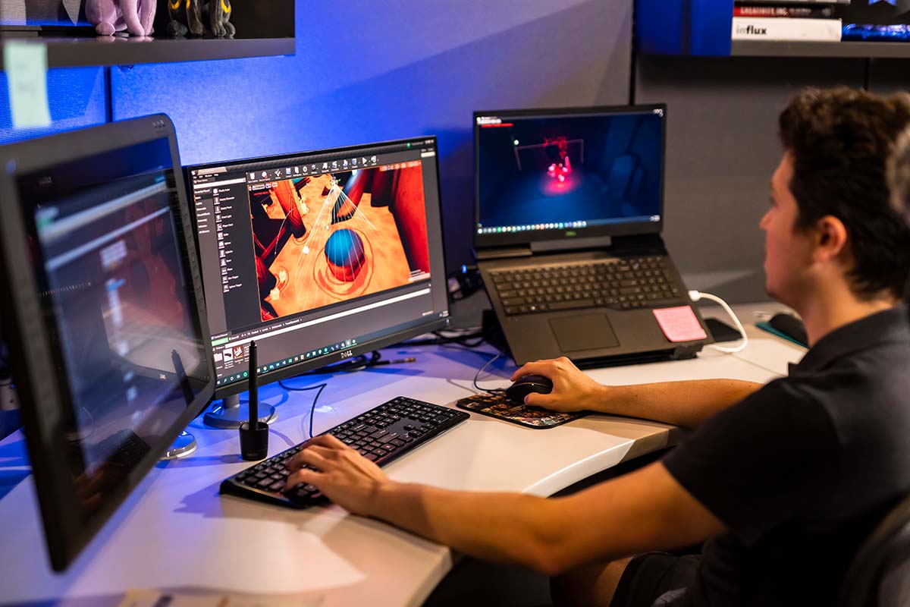
Games Design
Welcome to Games Design!
Games Design is a Level 3 course that teaches you skills to make and design video games
You’ll be learning about:
Key skills that are technical and professional that’ll open paths into higher education and creative industries.
How to make a video game on game engines such as Unreal Engine.
Design and model characters and assets on software such as Blender and Photoshop.
You’ll also be focusing on using software mentioned above to develop skills such as scripting, story making, making animations in 2D and 3D.

Slide 9

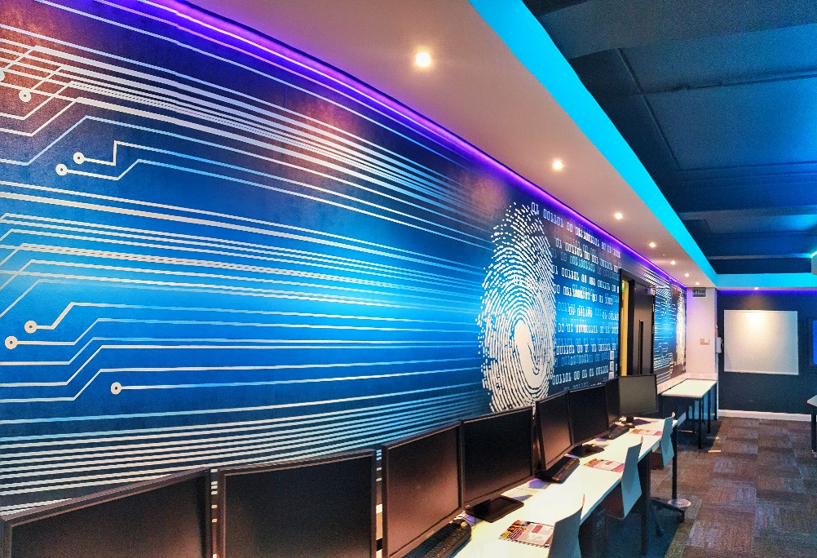

Cybersecurity
Welcome to Cybersecurity!
Cybersecurity is a Level 3 course that introduces you to a variety of essential computing skills, software and specialised units like exploring cryptography and cryptanalysis, IT audit and legislative frameworks, data crime like phishing, viruses, organised crime, fraud and hacking.

